Slide 1
Smart Medic Kit
Presented by-
Aman Satya
Govind K Rajesh
Atif zia

Slide 2
What is this about ?
Getting old is often synonymous with having to take copious amounts of medicines, and remembering which pills to take when becomes a rather arduous task.
The idea our team has come up with, hopes to solve this very problem. It has been perused that people who are on certain medication usually forget to take their medicines on their respective scheduled time. This seems to be a very paltry problem but actually it can be hazardous for health.
Taking all these issues in mind we came up with an idea which will take care of it.

Slide 3
How are we doing this?
Basically the apparatus consists of a pill box, which is specifically designed to accommodate sensors and an Ardino board.
This box will contain the various pills, separated by days of the week and times of the day
This setup is connected to an Android app, which is what handles the actual interaction with the user

Slide 4
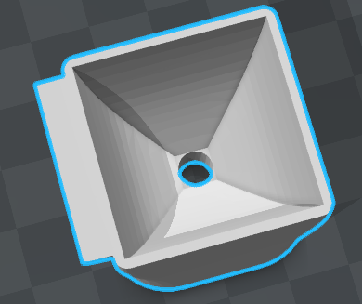
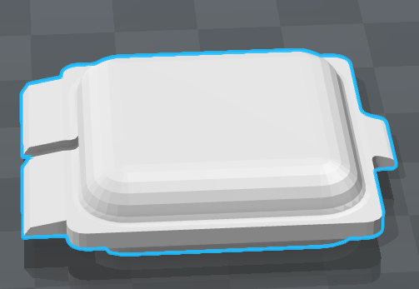
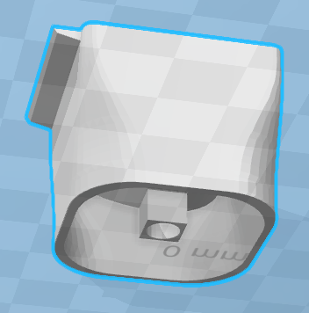
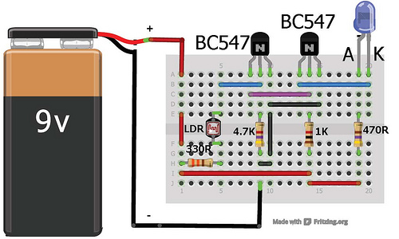
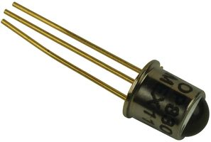
STRUCTURAL DESIGN
CIRCUIT DIAGRAM
IR SENSOR

Slide 5
Course of action taking place
When the time comes for the user to take their medication, the app will give them a notification in the form of an alarm or similar such medium.
The user must press a button on the pill box to shut off the said notification, and then take the pills.
After a specified amount of time, the sensors in the pill box (proximity sensors), will check if the required pills have been taken or not. If it finds that these pills are still in the box (ie, have not been taken), then it will trigger a secondary alarm through the app
If we contextualize the idea , all we are trying to do is , making whole course of action of having medicines , be completely digitized.

Slide 6



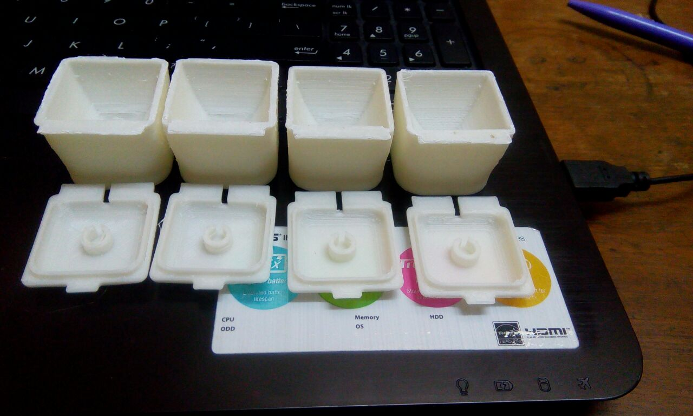
Cloud storage
User
App to control
Mechanical Box

Slide 7
Conclusion Through the above apparatus, we hope to make life easier for the elderly folk around the world.

Slide 8
THANK YOU

